Slide 1
Lecture 09 – Deep Learning and CNNs
Prof. André Gustavo Hochuli
gustavo.hochuli@pucpr.br
aghochuli@ppgia.pucpr.br
Notes:
Prof. André Hochuli

Slide 2
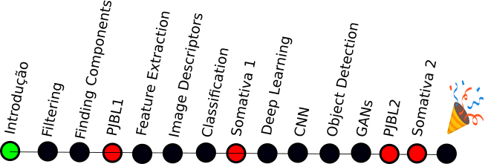
Topics
Deep Learning
Convolutional Neural Network
Lenet
Imagenet
Deep Networks
Practice
Computer Vision - Prof. André Hochuli
Lecture 09
Notes:
Prof. André Hochuli

Slide 3


Avaliação Institucional 2023.2
https://pucpr.vouavaliar.com.br/login.zul
Computer Vision - Prof. André Hochuli
Lecture 09
Notes:
Prof. André Hochuli

Slide 4
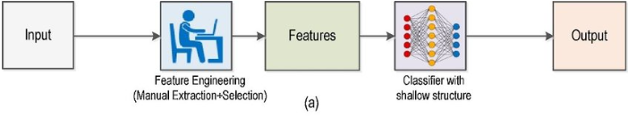
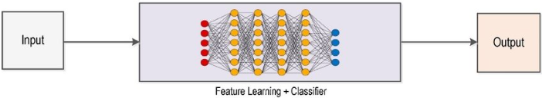
Traditional and Deep Learning
Traditional
Deep
Computer Vision - Prof. André Hochuli
Lecture 09
Notes:
Prof. André Hochuli

Slide 5
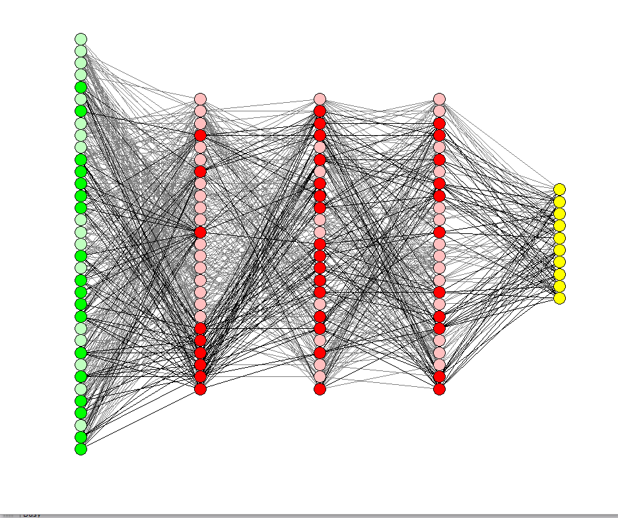
Deep Learning
Dense Multi-Layer Architectures
Computer Vision - Prof. André Hochuli
Lecture 09
Notes:
Prof. André Hochuli

Slide 6
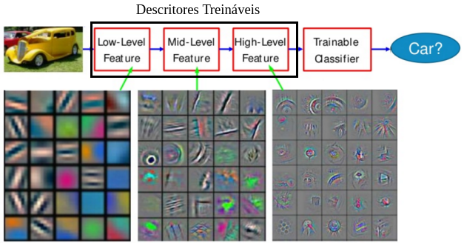
Deep Learning
Implicit feature extraction
Learnable Filters
Deep Abstraction
Computer Vision - Prof. André Hochuli
Lecture 09
Notes:
Prof. André Hochuli

Slide 7
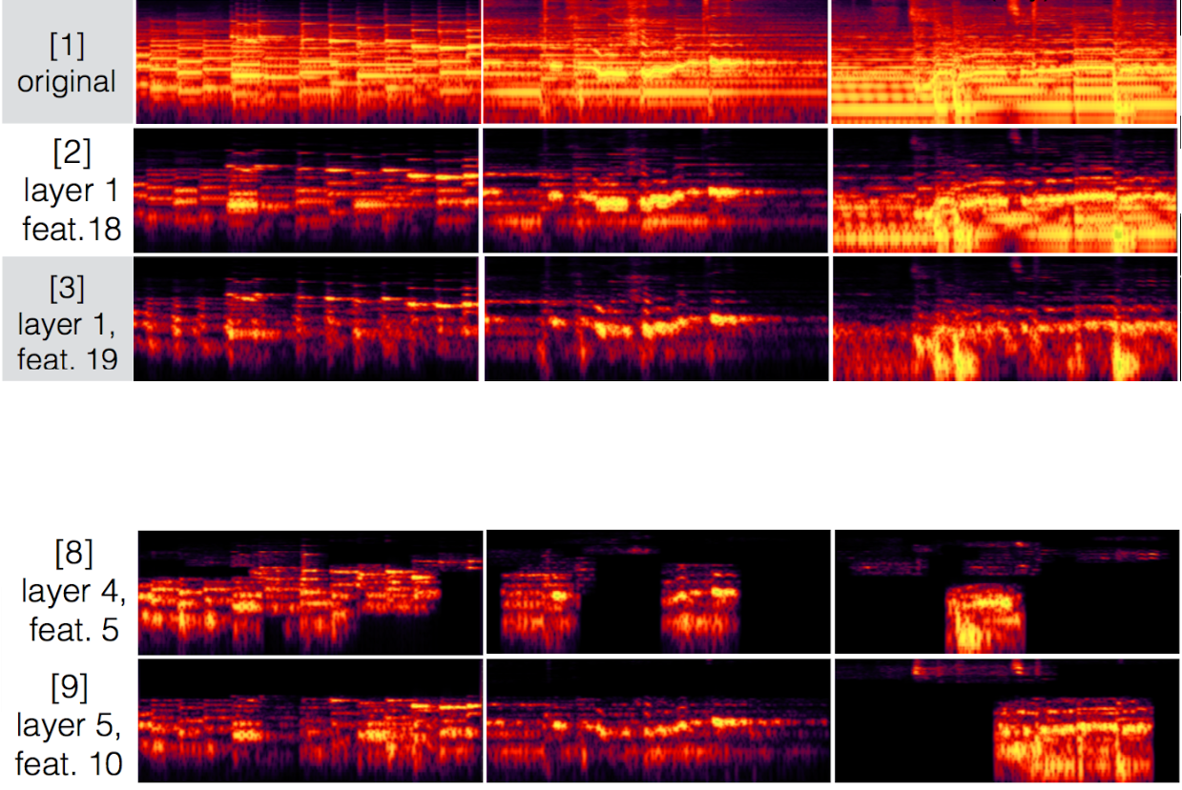
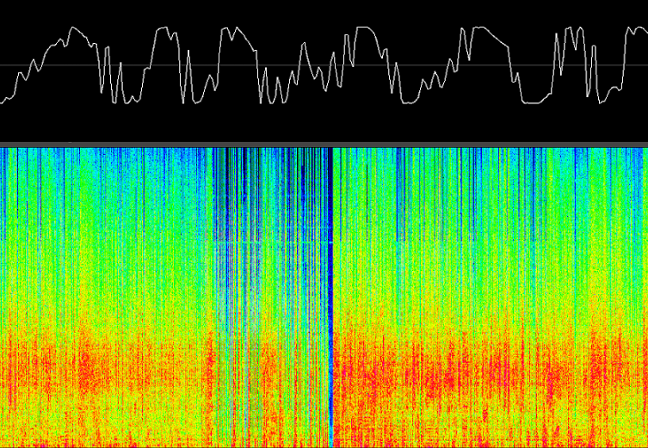
Deep Learning
Wide applied in the Computer Vision area (audio, images, video processing, etc.).
Piano
Piano+Vocal
Piano + Vocal
+ Bateria
Computer Vision - Prof. André Hochuli
Lecture 09
Notes:
Prof. André Hochuli

Slide 8
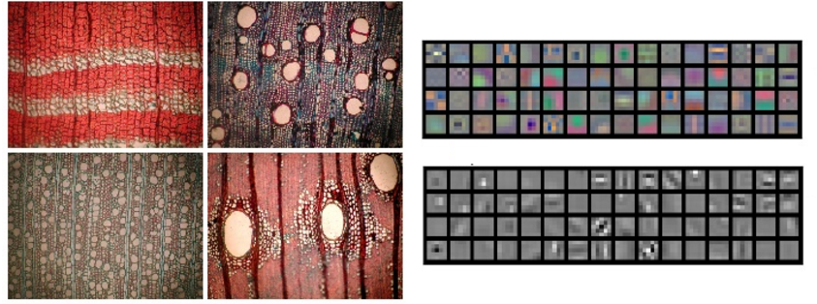
Deep Learning
Tissue Classification
Medical Images
Computer Vision - Prof. André Hochuli
Lecture 09
Notes:
Prof. André Hochuli

Slide 9
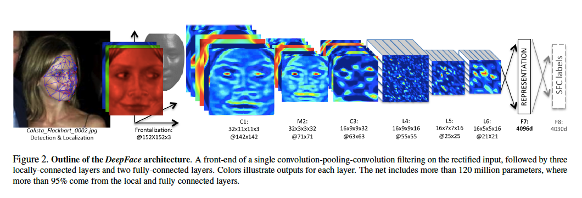
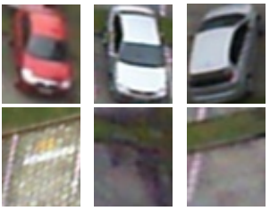
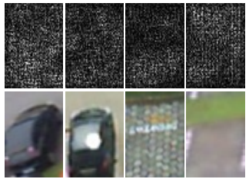
Deep Learning
Face
PKLot
Computer Vision - Prof. André Hochuli
Lecture 09
Notes:
Prof. André Hochuli

Slide 10
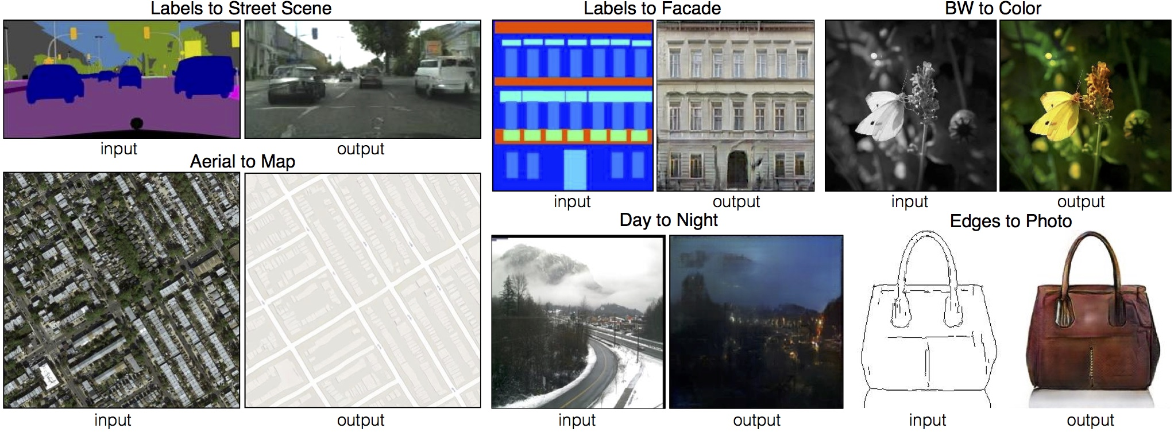
Deep Learning
Image Translation
Computer Vision - Prof. André Hochuli
Lecture 09
Notes:
Prof. André Hochuli

Slide 11
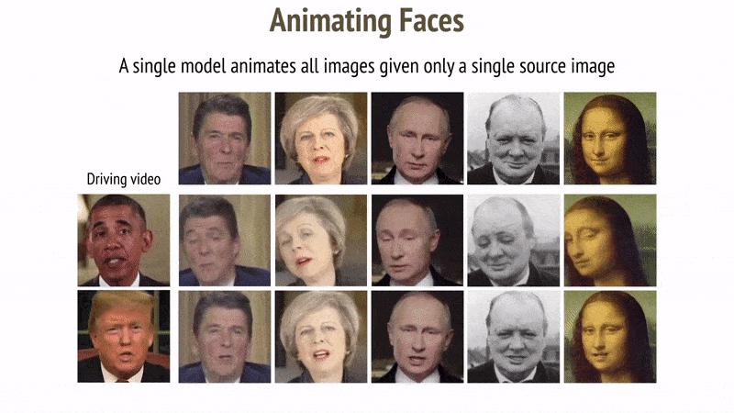
Deep Learning
Deep Fakes
https://www.youtube.com/watch?v=mUfJOQKdtAk
Computer Vision - Prof. André Hochuli
Lecture 09
Notes:
Prof. André Hochuli

Slide 12
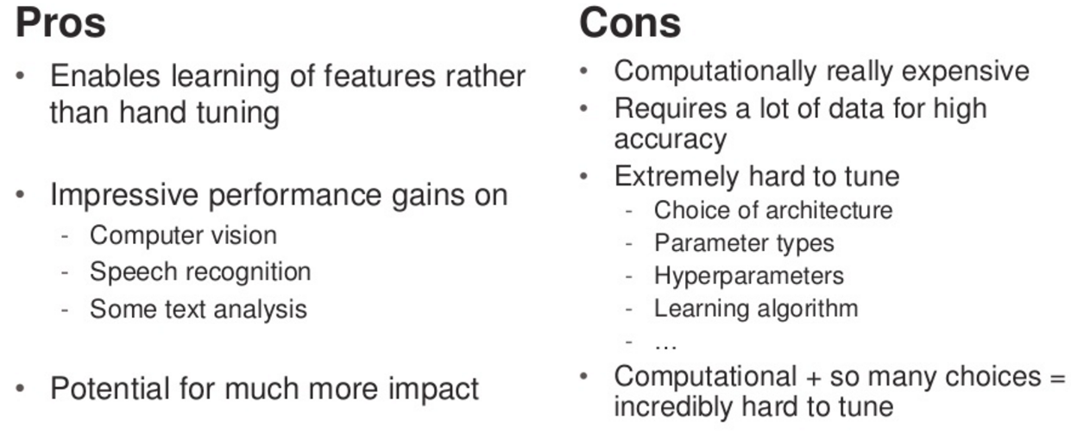
Deep Learning
Computer Vision - Prof. André Hochuli
Lecture 09
Notes:
Prof. André Hochuli

Slide 13
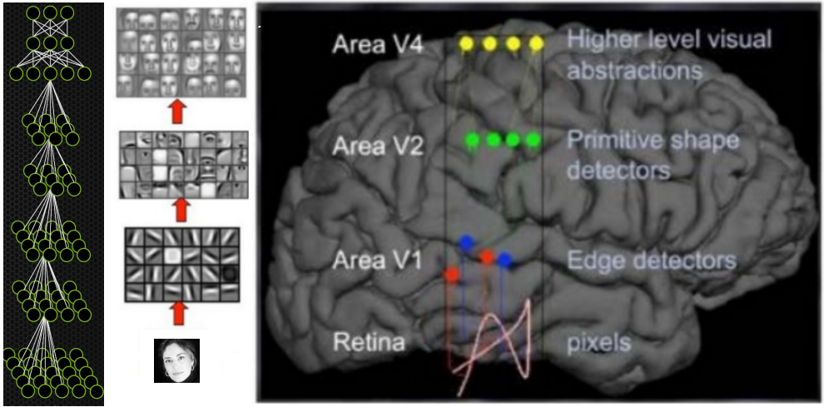
Convolutional Neural Networks
Lecun 90´s
Computer Vision - Prof. André Hochuli
Lecture 09
Notes:
Prof. André Hochuli

Slide 14
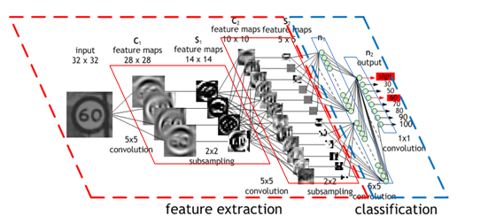
Convolutional Neural Networks
Feature Extraction
Learnable Filters
Classification
Fully-Connected
SVM
….
Computer Vision - Prof. André Hochuli
Lecture 09
Notes:
Prof. André Hochuli

Slide 15
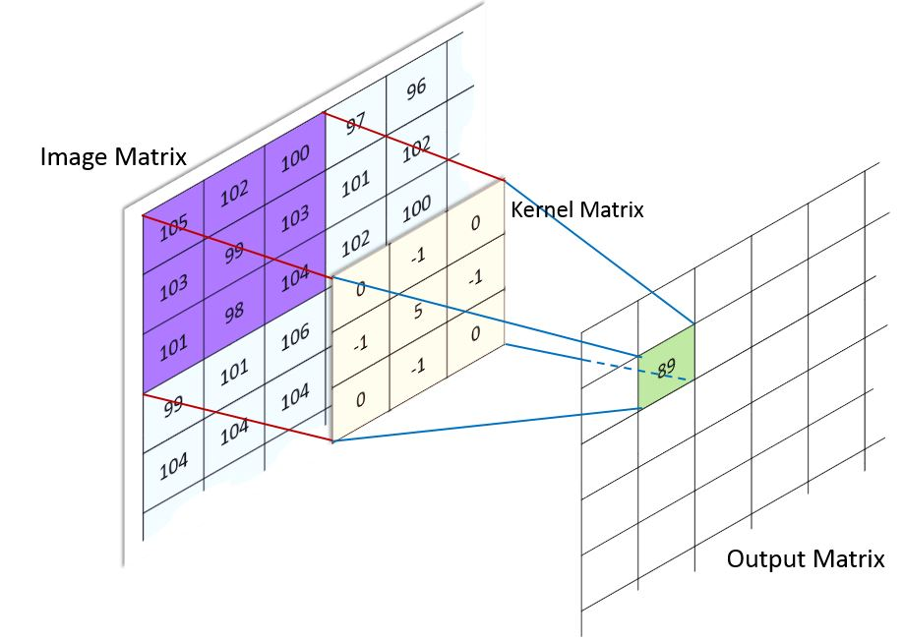
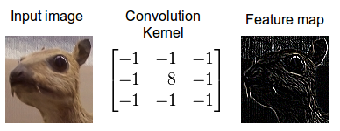
Convolutional Neural Networks
Image Convolution
Computer Vision - Prof. André Hochuli
Lecture 09
Notes:
Prof. André Hochuli

Slide 16
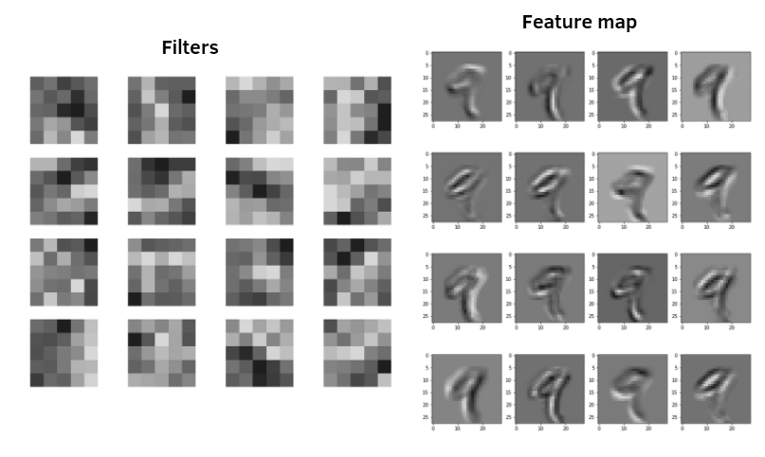
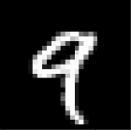
Convolutional Neural Networks
Learned Filters and Resulting Feature Map
Computer Vision - Prof. André Hochuli
Lecture 09
Notes:
Prof. André Hochuli

Slide 17
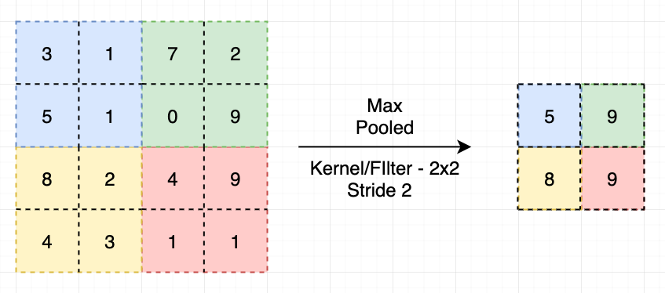
Convolutional Neural Networks
Pooling Layer
Computer Vision - Prof. André Hochuli
Lecture 09
Notes:
Prof. André Hochuli

Slide 18
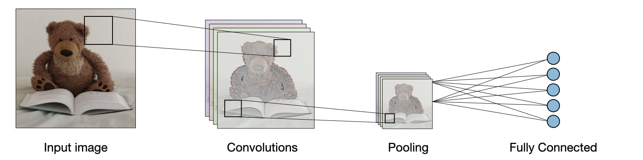
Convolutional Neural Networks
All Together
Computer Vision - Prof. André Hochuli
Lecture 09
Notes:
Prof. André Hochuli

Slide 19
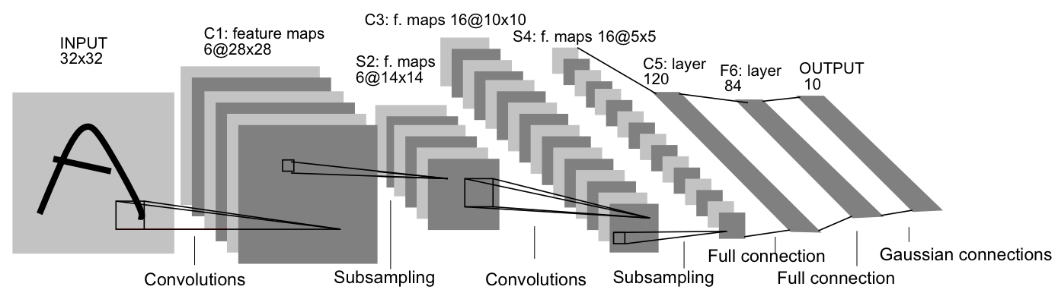
Convolutional Neural Networks
Lenet
Yan Lecun – 90´s (Bell Labs / IBM / FACEBOOK)
Handwritten Digits
~60 K Parameters
~345 K Connections
Computer Vision - Prof. André Hochuli
Lecture 09
Notes:
Prof. André Hochuli

Slide 20
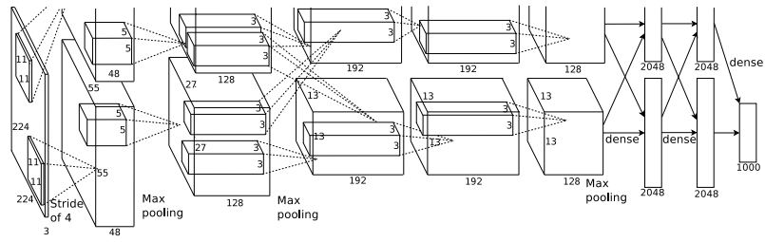
Convolutional Neural Networks
AlexNet
Alex Krizhevsky – 2012 (Krizhevsky Net)
Imagenet 2012 Challenge (1000 classes)
→ 1.2 M Train, 50K Val, 150K Test
2012 Winner (15.3% Error - Top 5)
→ 2° SIFT Based (26.2%)
Computer Vision - Prof. André Hochuli
Lecture 09
Notes:
Prof. André Hochuli

Slide 21
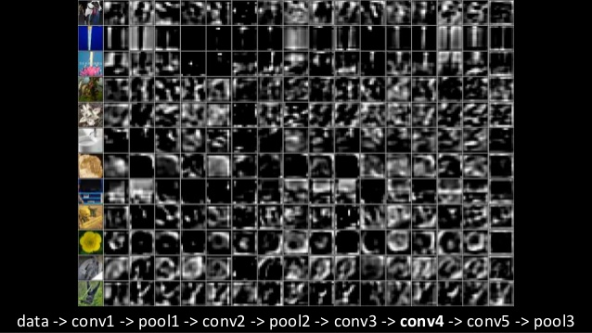
Convolutional Neural Networks
Alexnet
Computer Vision - Prof. André Hochuli
Lecture 09
Notes:
Prof. André Hochuli

Slide 22

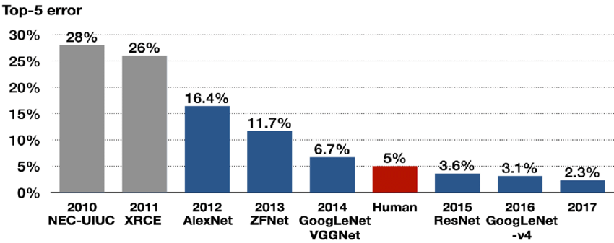
Imagenet Challenge
Imagenet 2012 Challenge
1000 classes
1.2 M Train
50K Val
150K Test
[LINK TO ACCs]
Computer Vision - Prof. André Hochuli
Lecture 09
Notes:
Prof. André Hochuli

Slide 23
Let's Code
[LINK]
Computer Vision - Prof. André Hochuli
Lecture 09
Notes:
Prof. André Hochuli

